Slide 1
rWHALE: Regional Workflow for Hazards and Loss Estimation
Wael Elhaddad
NHERI SimCenter
Programming Bootcamp 2019

Slide 2
Outline
Overview of the Computational Framework
Regional Workflows using rWHALE
Regional Testbed Simulations
San Francisco Testbed
Anchorage Testbed
Demos & Exercises
Local computer
High performance computer (HPC)

Slide 3



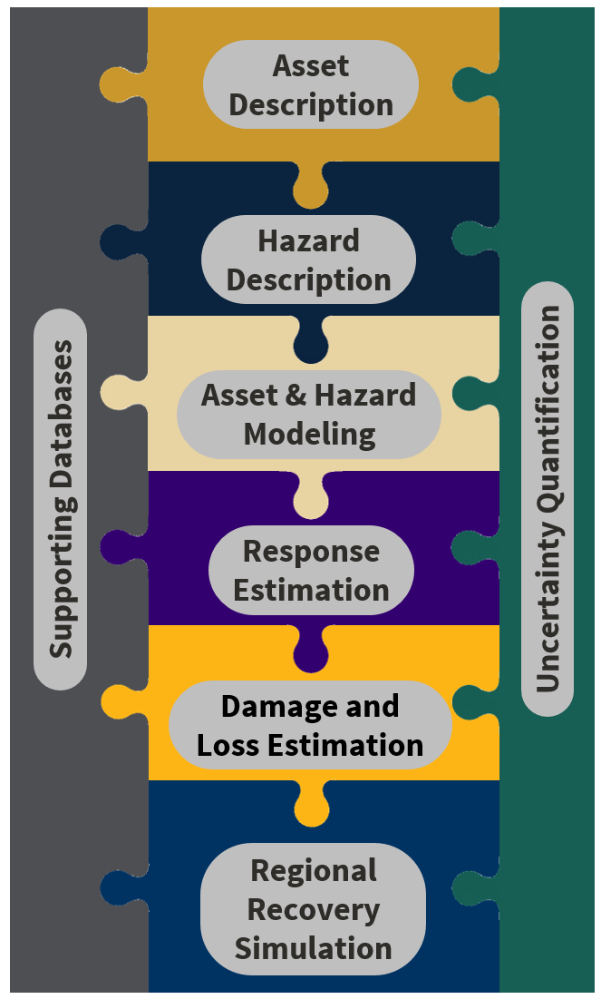
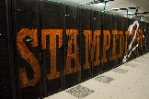




NHERI SimCenter
“Transforming the nation’s ability to understand and mitigate adverse effects of natural hazards on the built environment through computational simulation”
Data storage and HPC access
Cloud-enabled research tools, scalable to run on HPC
Emphasis on uncertainty quantification
Educational resources
SimCenter’s
Application Framework
SimCenter Research Tools
Back-end
Front-end
Notes:
DesignSafe’s Agave interface allows access to their resources through web-based or cloud-based technologies.
The SimCenter leverage this cloud platform to develop desktop research applications that facilitates running large simulations on HPC. This requires the SimCenter to deploy its application framework(backend) on DesignSafe computing resources.

Slide 4
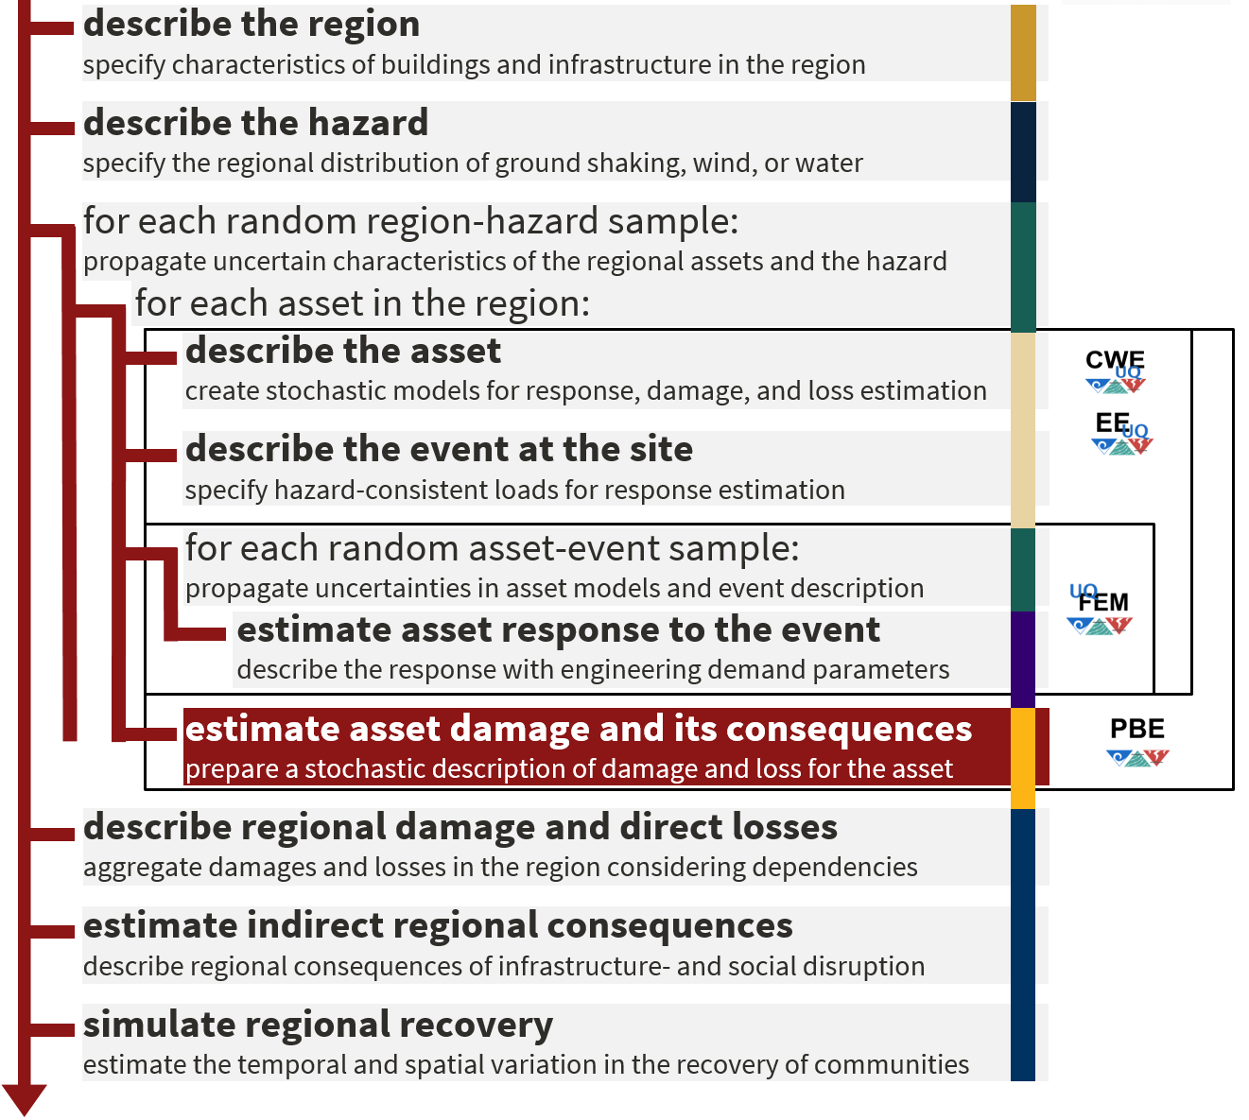


Framework for Building Workflow Applications
Run in the cloud
OR
Run Locally
Notes:
This slide explains the application framework and shows where research applications fall within this framework.

Slide 5
Computations Workflow
Regional workflow
Buildings Database
Regional Simulation
Damage &
Loss
Hazard
Buildings Database
Building Workflow
Single building workflow
BIM
EVENT
SAM
EDP
DL
BIM: Building Information Model
SAM: Structural Analysis Model
EDP: Engineering Demand Parameters
DL: Damage & Loss
Hazard

Slide 6
Workflow Overview
Applications & Interfaces
Files workflow (Interfaces)
Buildings Database
BIM
EVENT
SAM
EDP
DL
Obtain EDP
performUQ
createBIM
createEVENT
createSAM
createEDP
performSIM
createLOSS
Applications workflow
BIM: Building Information Model
SAM: Structural Analysis Model
EDP: Engineering Demand Parameters
DL: Damage & Loss
lighter text are Inputs/Outputs
darker text are applications

Slide 7
Forward Uncertainty Propagation
Uncertainties are handled using Dakota
Each workflow application is called initially to define random variables
Dakota samples the random variables and runs the workflow applications for each sample
Sample-1
pBIM
BIM
EVENT
SAM
EDP
DL
performUQ i.e. Dakota
pSAM
DL
EVENT
Sample-N
pBIM: Parameterized BIM
pSAM: Parameterized SAM
BIM
EVENT
SAM
EDP
DL
Adams, B.M., Bauman, L.E., Bohnhoff, W.J., Dalbey, K.R., Ebeida, M.S., Eddy, J.P., Eldred, M.S., Hough, P.D., Hu, K.T., Jakeman, J.D., Stephens, J.A., Swiler, L.P., Vigil, D.M., and Wildey, T.M., "Dakota, A Multilevel Parallel Object-Oriented Framework for Design Optimization, Parameter Estimation, Uncertainty Quantification, and Sensitivity Analysis: Version 6.8 Theory Manual," Sandia Technical Report SAND2014-4253, May 2018.

Slide 8
Registered Applications For Regional Earthquake Simulations
Type
Name
Description
GenericBimDatabase
Creates a simple BIM from a building flat file (csv)
createBIM
UrbanSimDatabase
Creates a simple BIM from
UrbanSim
simulation outputs
LLNL_SW4
Gets Event input from SW4
outputs
createEVENT
SHA
Computes event input using SHA and record selection/scaling
-
GM
createSAM
MDOF_LU
Creates a MDOF shear building model
createEDP
StandardEarthquakeEDP
Defines the standard EDPs used for a seismic event
performSIM
OpenSeesSimulation
Performs simulation using
OpenSees
and calculates the EDPs
createLOSS
FEMAP58_LU
Calculates damage and loss estimates using FEMA P-58 procedure
performUQ
DakotaFEM
Propagates uncertainty in all applications using Dakota

Slide 9
Registered Applications For Regional Wind Simulations
Type
Name
Description
GenericBimDatabase
Creates a simple BIM from a building flat file (csv)
createBIM
UrbanSimDatabase
Creates a simple BIM from
UrbanSim
simulation outputs
ASCE 7-10
Generate wind loading using ASCE7-10 procedure
createEVENT
Stochastic Wind
Generate wind loading using stochastic process models
createSAM
MDOF_LU
Creates a MDOF shear building model
createEDP
StandardWindEDP
Defines the standard EDPs used for a wind event (e.g. pressure)
performSIM
OpenSeesSimulation
Performs simulation using
OpenSees
and calculates the EDPs
createLOSS
PELICUN(Hazus)
Calculates damage and loss estimates using Hazus methodology
performUQ
DakotaFEM
Propagates uncertainty in all applications using Dakota

Slide 10
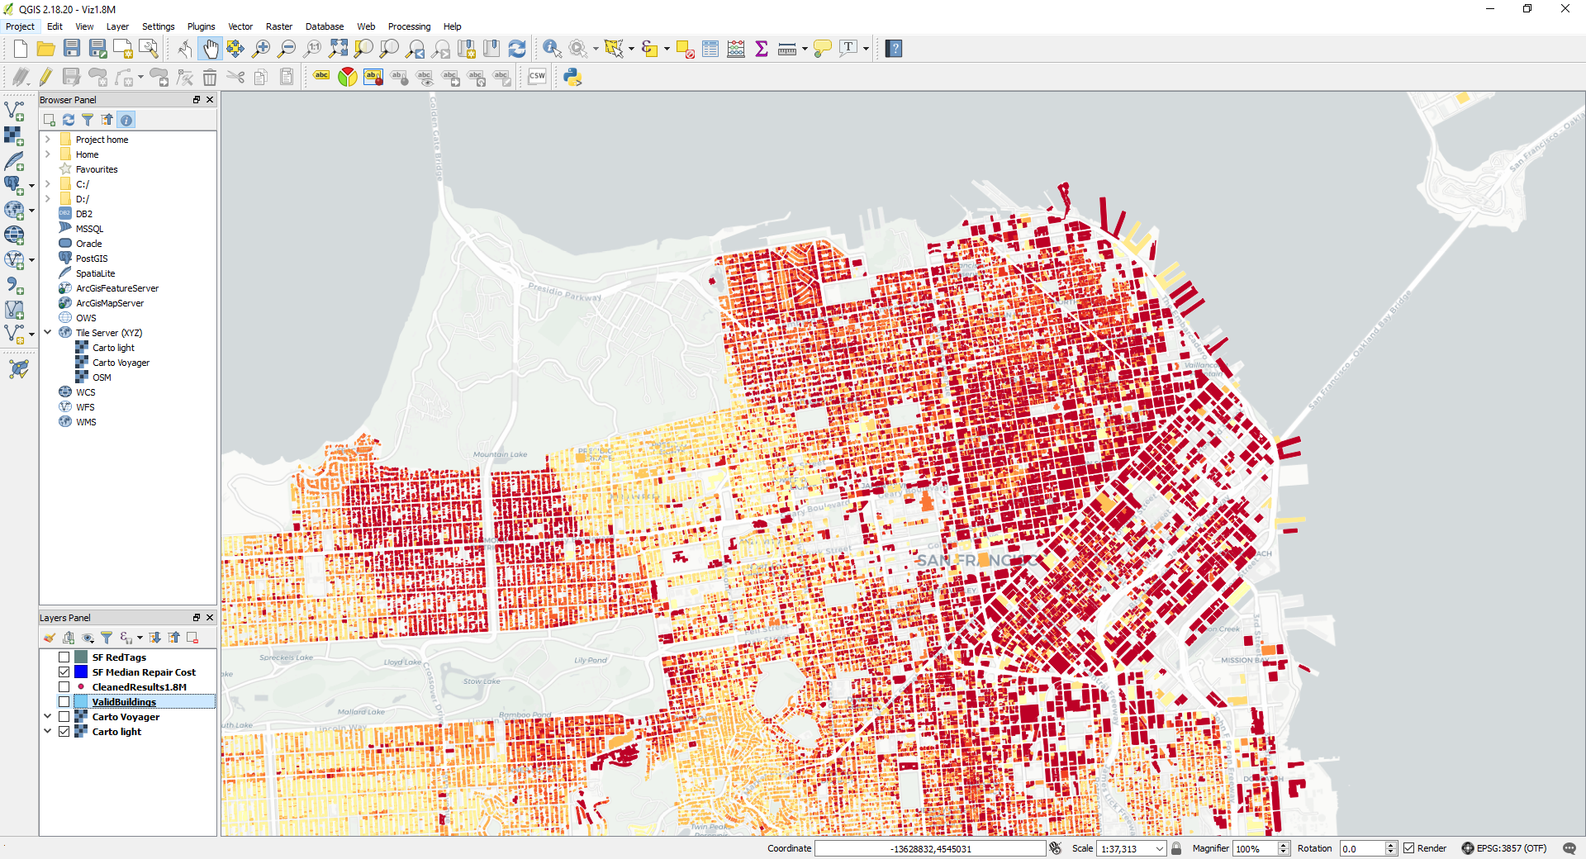
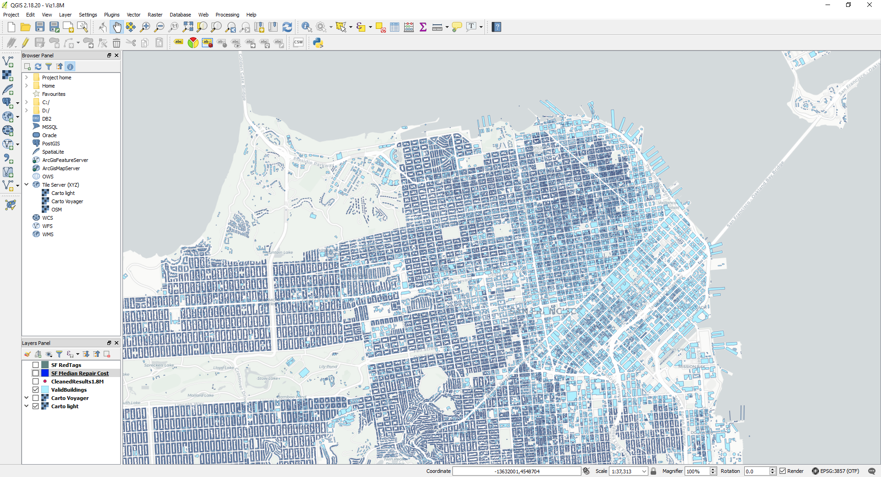
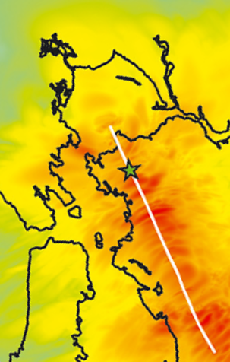
Regional Simulation Tools
San Francisco Bay Area Testbed
M7.0 Hayward
Hazard Consequences
Building Inventory

Slide 11
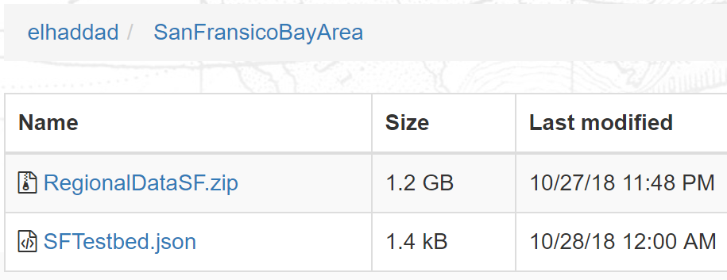

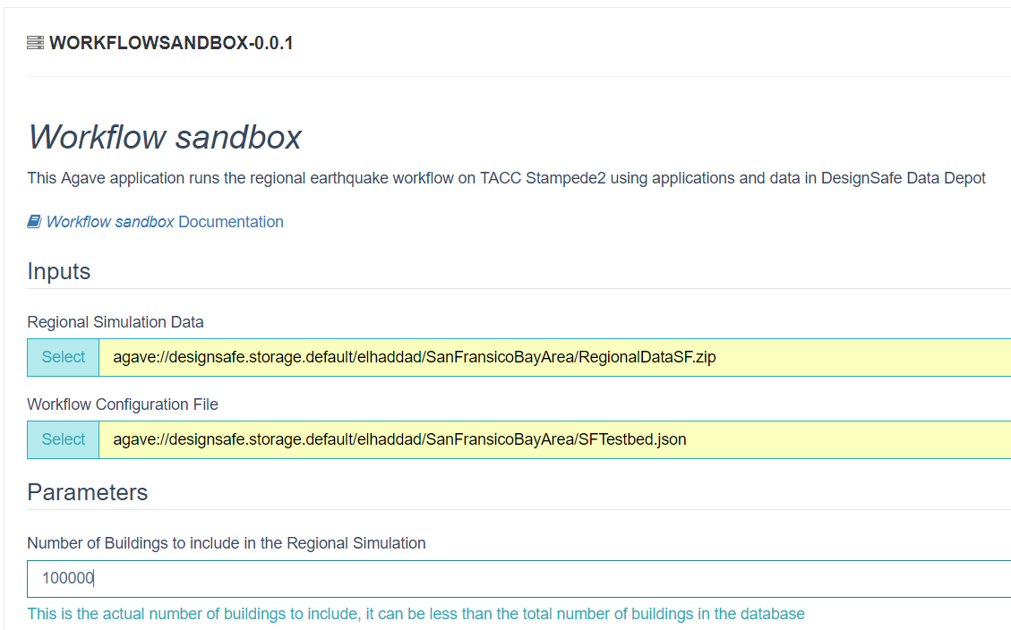
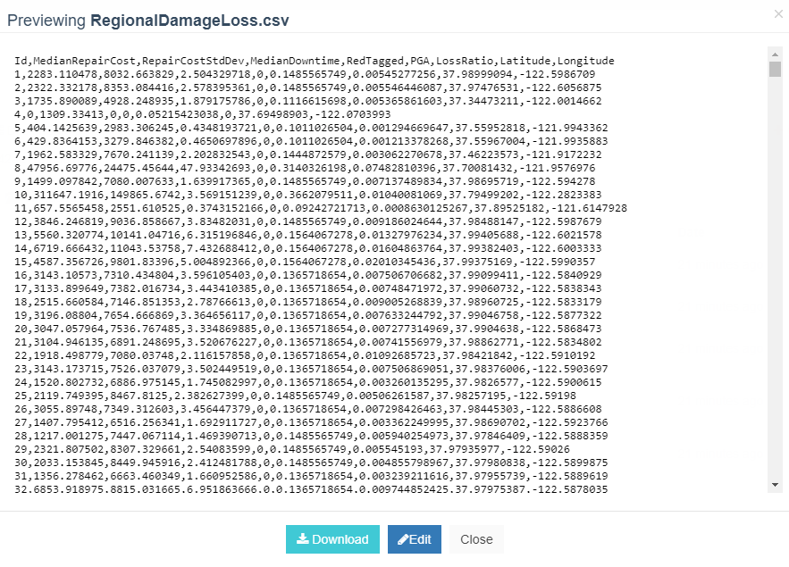
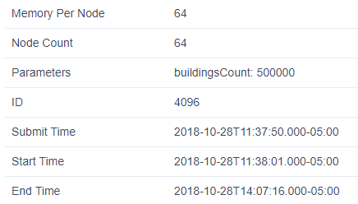
Regional Simulation Tools
Regional simulation using HPC through DesignSafe Workspace

Slide 12
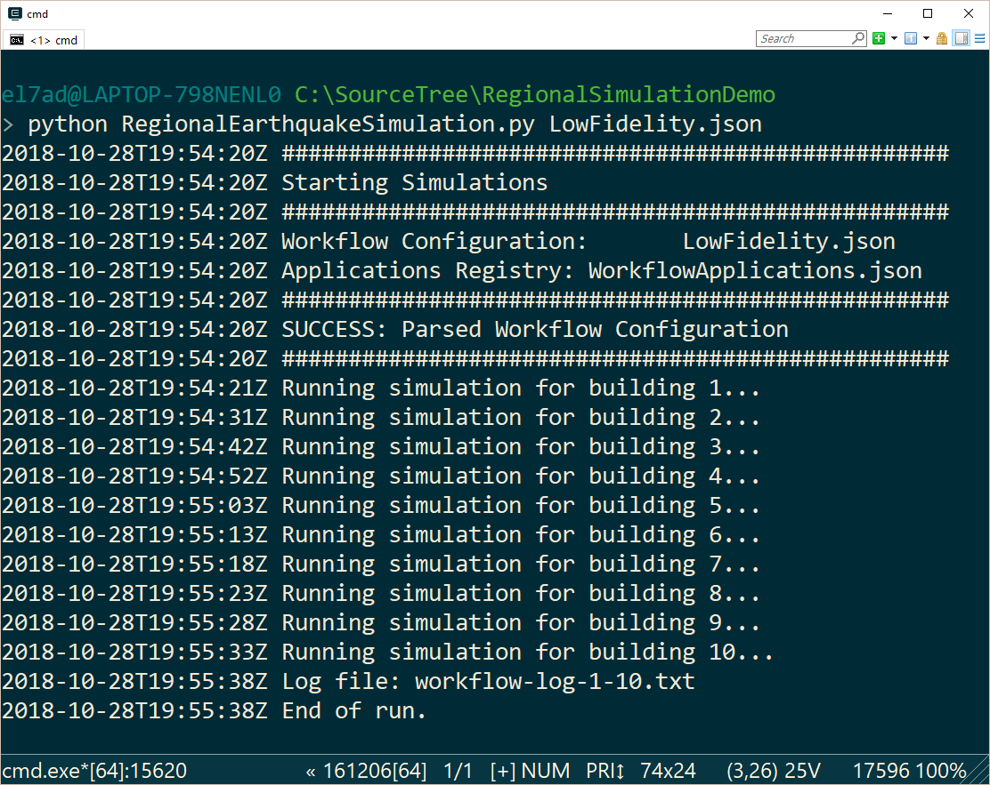
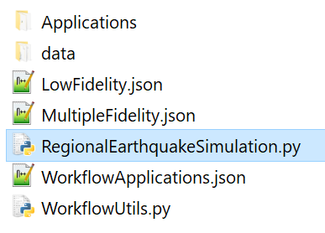
Regional Simulation Tools
Small scale simulation using Local Computer
Applications,
Sample Data &
Examples
Runs Locally as a console application

Slide 13
Regional Simulation Tools
The Framework provides applications with standard interfaces
Buildings
Hazard
Modeling
Losses
Generic BIM
LLNL_SW4
MDOF_LU
FEMA P58_LU
UrbanSIM
SHA-GM.py
Concrete Shear Walls
Pelicun
Document Database
NNGM.py
Multiple Fidelity Modeling
Generic BIM
Seismic
Hazard
Analysis
Simple Model
Hazus
Low Fidelity
Earthquake
Simulation
Workflows
High Fidelity
Detailed BIM
Seismic
Wave
Propagation
High Fidelity Model
FEMA P58

Slide 14

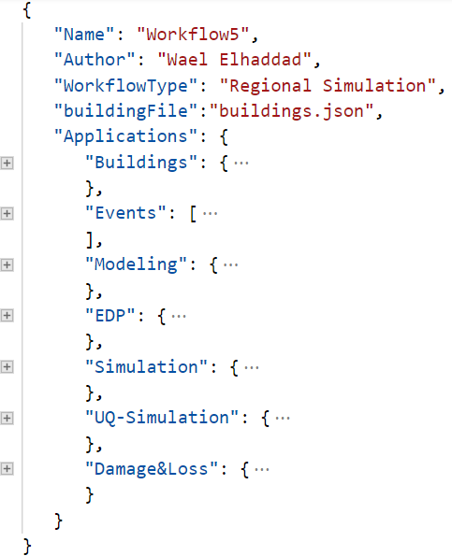
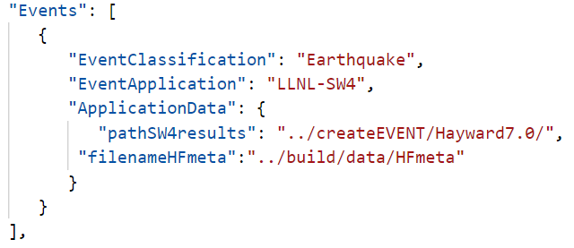
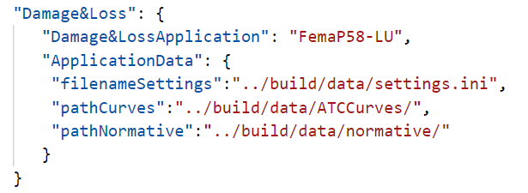
Regional Simulation Configuration
Configuration File

Slide 15
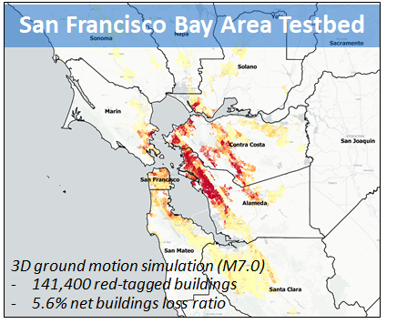
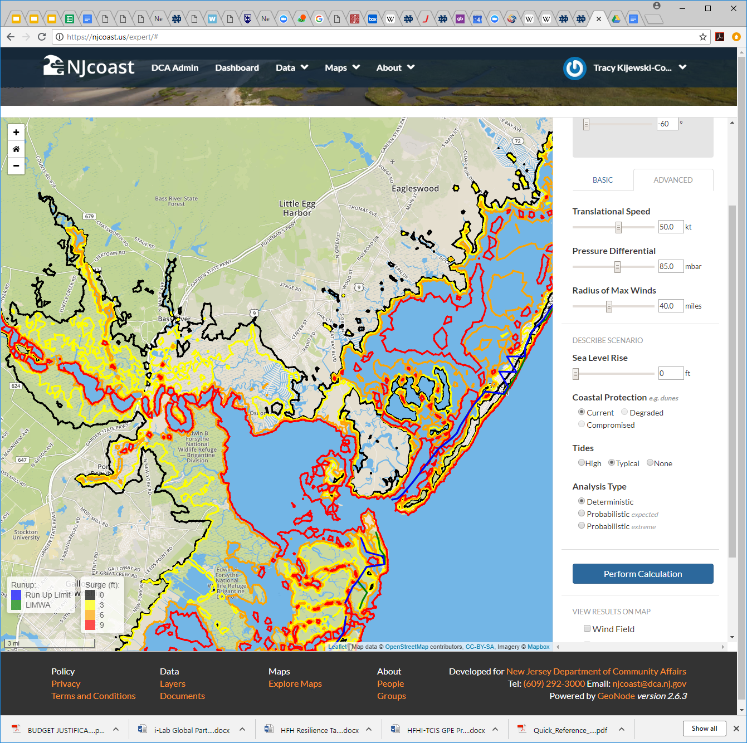
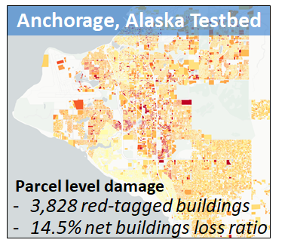
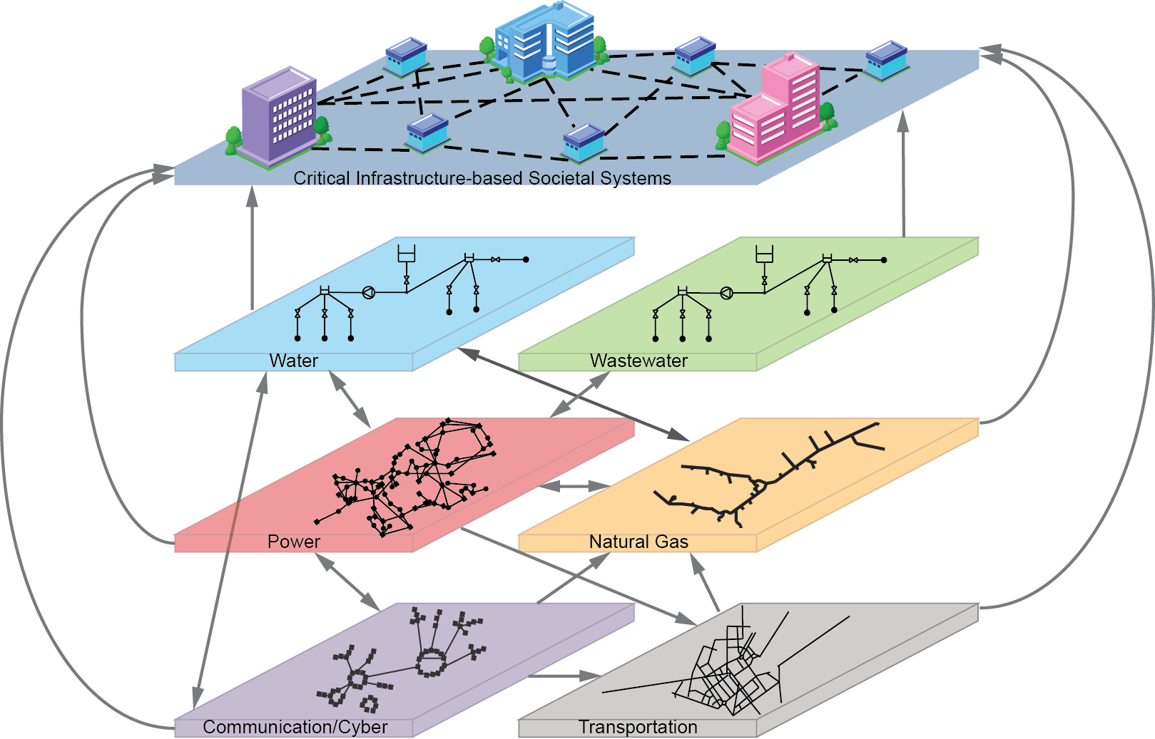
Regional Testbeds Using rWHALE
Atlantic City, NJ Storm Testbed
Memphis, TN Lifelines Testbed

Slide 16
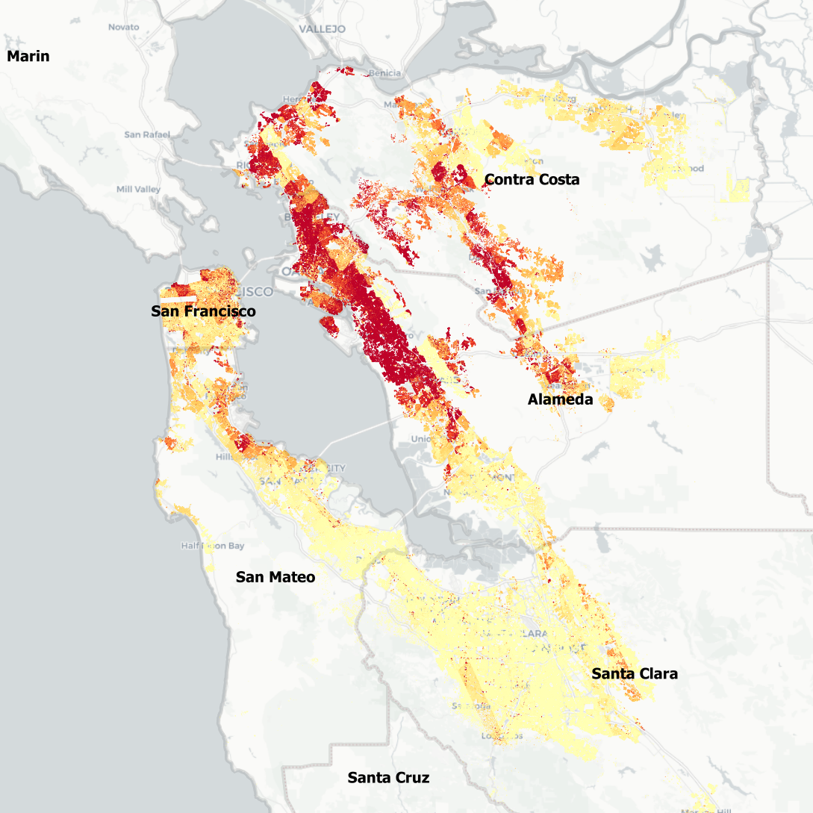
Example Simulation: Earthquake in San Francisco Bay Area
M7.0 Rupture along the Hayward fault modeled using SW4 [1]
1,843,351 buildings were included in the Simulation
Building information is based on UrbanSim data
Damage and Loss calculation using FEMAP58_LU [2]
Structural analysis models are based on MDOF_LU [3]
Red tagged buildings: 141,459
Buildings damage: $84.1 billion
Net buildings damage ratio: 5.6%
Building Loss Ratio
[1] A. J. Rodgers, A. Pitarka, N. A. Petersson, B. Sjögreen and D. B. McCallen, "Broadband (0–4 Hz) ground motions for a magnitude 7.0 Hayward fault earthquake with three‐dimensional structure and topography," Geophysical Research Letters, vol. 45, p. 739–747, 2018.
[2] Zeng X., Lu X.Z., Yang T., Xu Z., "Application of the FEMA-P58 methodology for regional earthquake loss prediction", Natural Hazards (2016), 10.1007/s11069-016-2307-z
[3] X. Lu, B. Han, M. Hori, C. Xiong and Z. Xu, "A coarse-grained parallel approach for seismic damage simulations of urban areas based on refined models and GPU/CPU cooperative computing," Advances in Engineering Software, vol. 70, pp. 90-103, 2014.

Slide 17
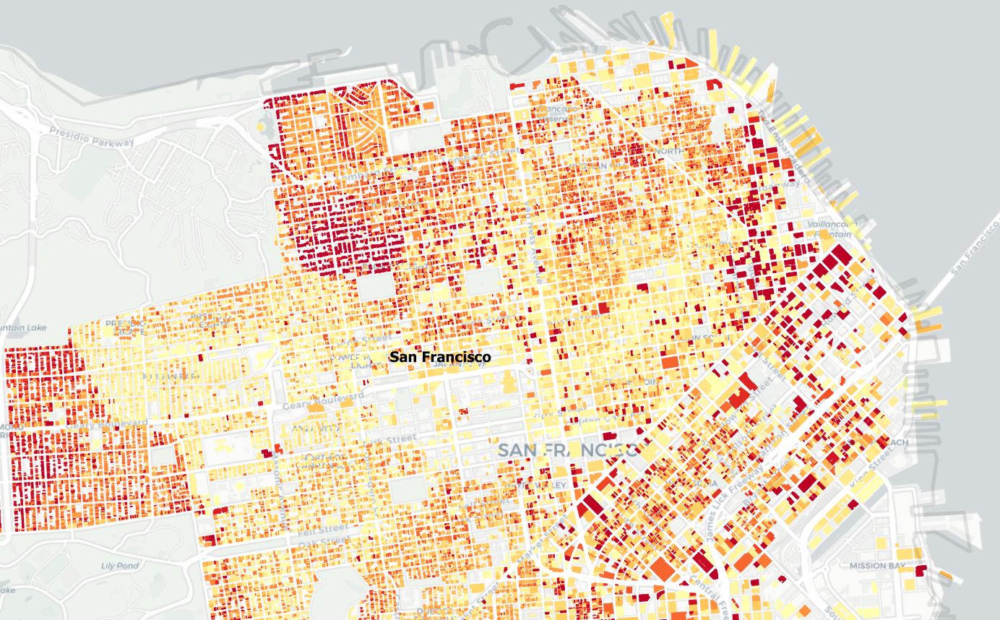
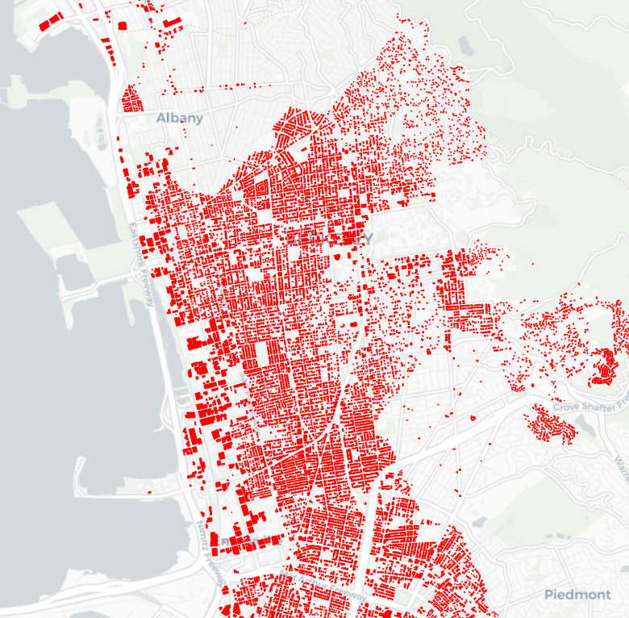
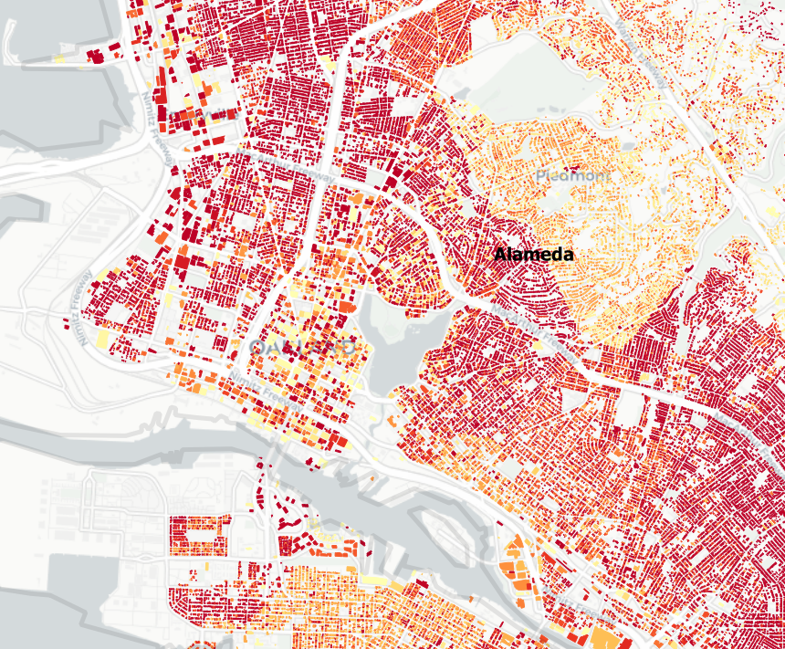
Visualization
Visualization on parcel level results can be done in GIS tools (e.g. QGIS)
Loss Ratios
Red Tagged Buildings

Slide 18
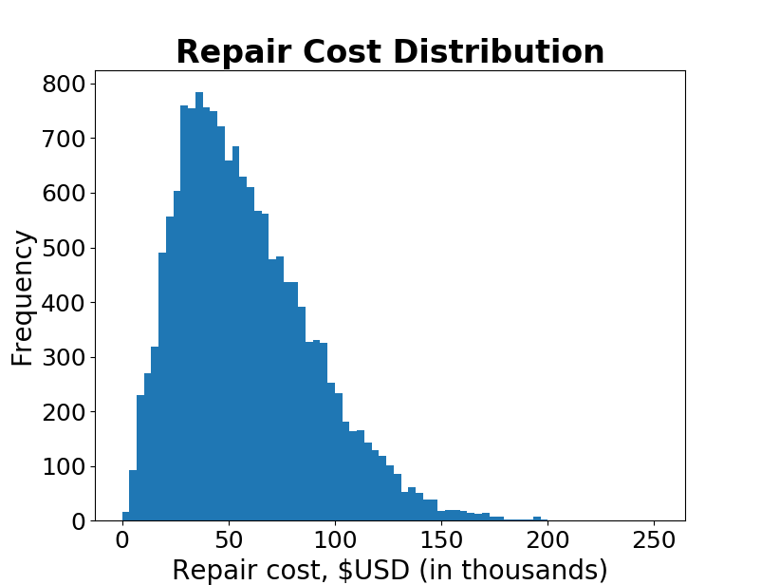
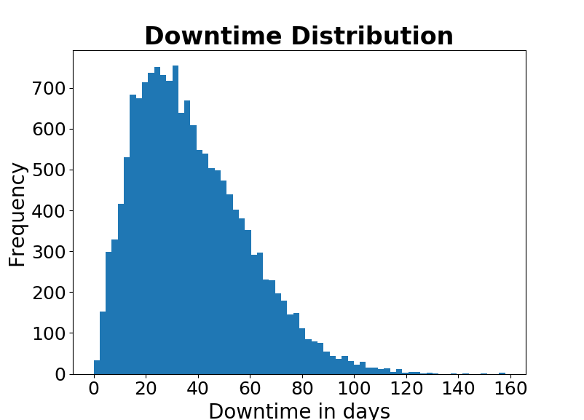
Parcel Level Results
Loss Ratios

Slide 19
Comparison To HayWired Scenario
HayWired Scenario: A study lead by USGS, involving approximately 60 partners, to simulate the effects and consequences of a hypothetical, yet scientifically realistic, magnitude M7.0 earthquake on the Hayward fault.
 | HayWired Scenario | SimCenter Testbed
Number of Buildings | 3 Million | 1.84 Million
Red Tagged Buildings | 101,000 | 141,459
Building Damage | $30.3 Billion | $84.1 Billion
Net Damage Ratio | 2.91% | 5.6%
Total Buildings Cost | $1.04 Trillion | $1.5 Trillion
Detweiler, S.T., and Wein, A.M., eds., 2018, The HayWired earthquake scenario—Engineering implications: U.S. Geological Survey Scientific Investigations Report 2017–5013–I–Q, 429 p., https://doi.org/10.3133/sir20175013v2.

Slide 20
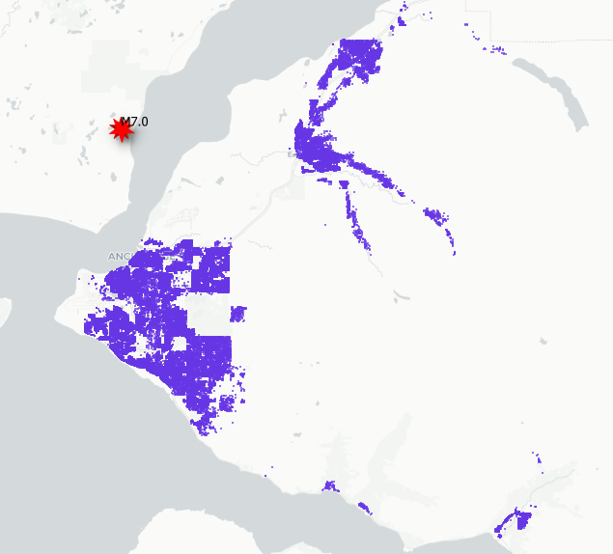
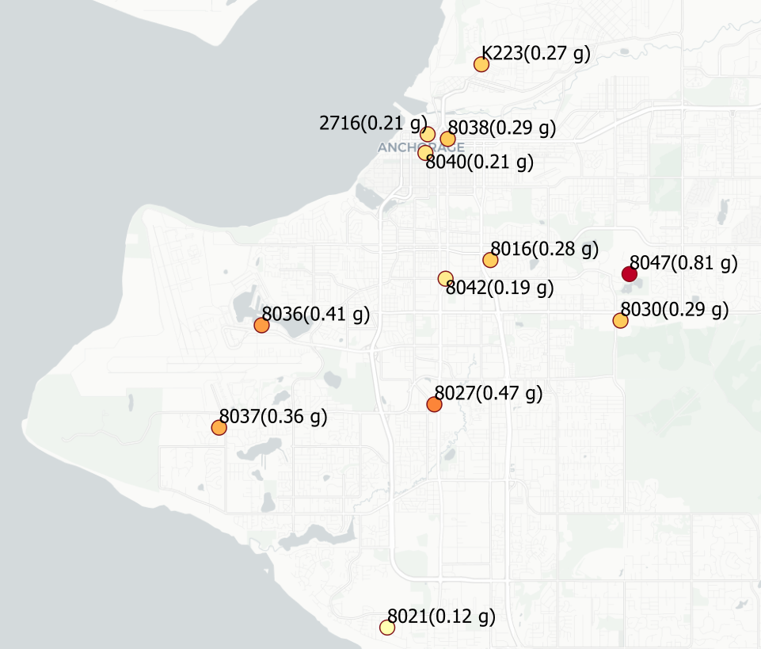
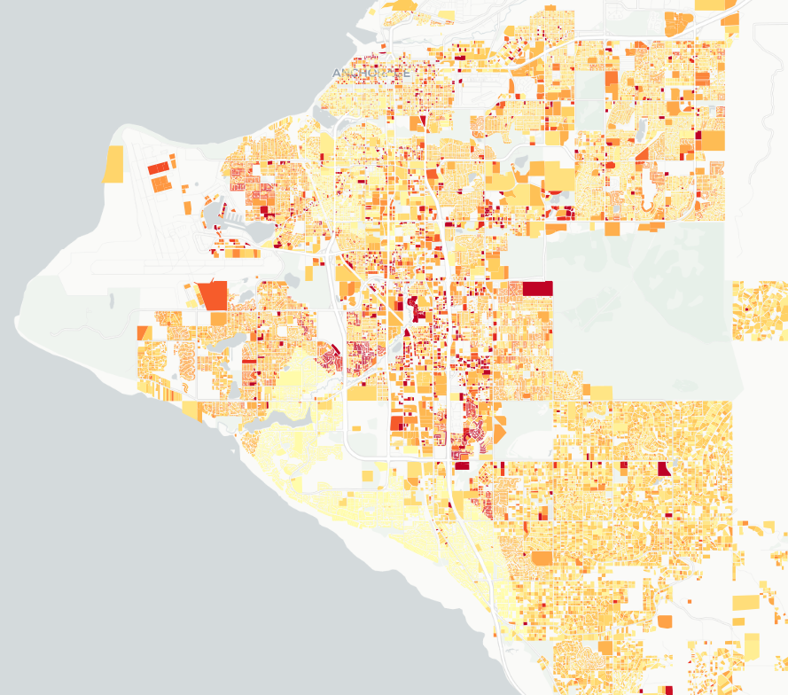
Anchorage Earthquake Testbed
Tax data for 97,421 buildings/parcels (Municipality of Anchorage appraisal records)
Data was processed to obtain BIM for 84,435 buildings
78,509 Residential and 7,926 Commercial buildings
Event: Magnitude 7.0 earthquake near Anchorage, Alaska Nov 30th 2018
12 Recorded ground motions available through CESMD
Anchorage, Alaska Testbed
~12,000 buildings in Eagle River
Parcel level damage
3,828 red-tagged buildings
14.5% net buildings loss ratio
Notes:
Objective: Demonstrate a computational workflow for a significant simulation that can engage the broad NEHRI community
These testebeds demonstrate the Framework’s connectivity of tools and data by showing how a Regional Earthquake Workflow can analyze each building in the region.
Uses a simplified nonlinear, MDOF model for each building.
Loss estimates are based on a FEMA P-58 methodology.

Slide 21
Demos

Slide 22
Questions & Discussion

Slide 23
Extra Slides

Slide 24
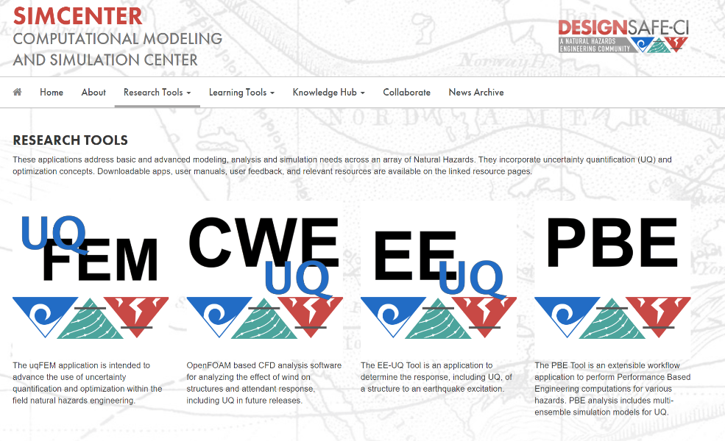
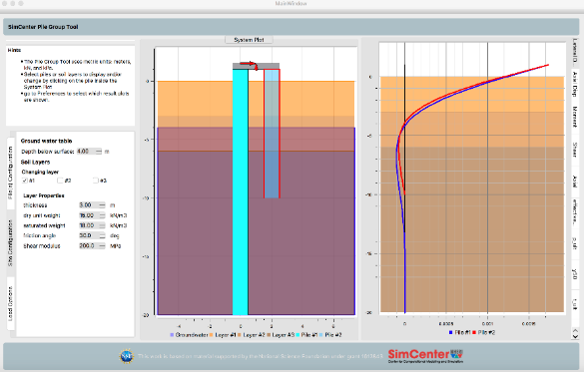



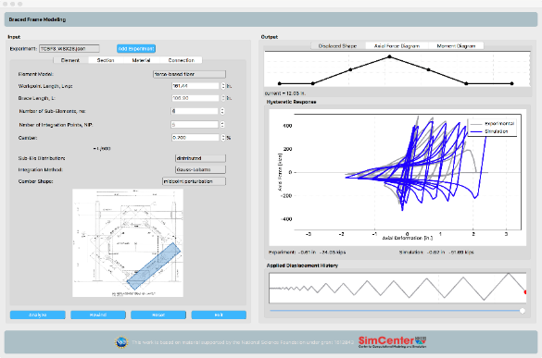

Research and Educational Tools
SimCenter Research Tools
SimCenter Educational Apps
Open source software: https://github.com/NHERI-SimCenter

Slide 25
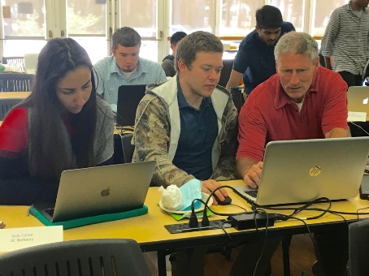
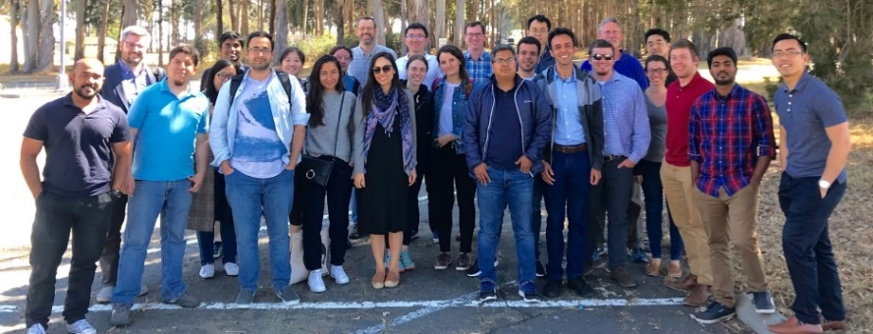

ECO Activities
Community Engagement
Regional Hazard Testbeds
Open-source, Community Driven Software
SimCenter Tool Training Workshop (~June 2019)
Summer Programming Bootcamp (~July 2019)
SimCenter Webinars
Dedicated Slack discussions
Multi-disciplinary REU program
https://simcenter.designsafe-ci.org/join-community/

